Slide 1
Apache Tomcat 8
Parameswari Ettiappan

Slide 2
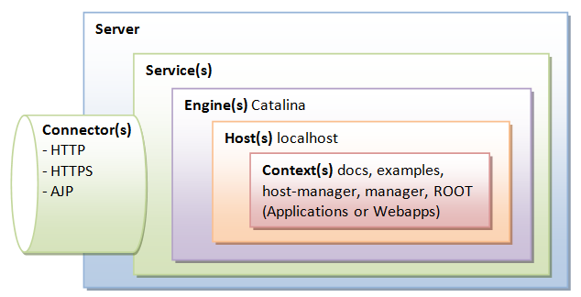
Tomcat architecture

Slide 3
Server
A Tomcat instance, or server, is the top-level component in Tomcat’s container hierarchy.
Only one Tomcat instance can live in a single Java Virtual Machine (JVM).
This approach makes all other Java applications, running on the same physical machine as Tomcat server, safe in case Tomcat and/or its JVM crashes.
<Server>
<Service>
<Connector />
<Engine>
<Host>
<Context> </Context>
</Host>
</Engine>
</Service>
</Server

Slide 4
Server
The first container element referenced in this snippet is the <Server> element.
It represents the entire Catalina servlet engine and is used as a top-level element for a single Tomcat instance.
The <Server> element may contain one or more <Service> containers.
A Server element represents the entire Catalina servlet container.
Therefore, it must be the single outermost element in the conf/server.xml configuration file.
Its attributes represent the characteristics of the servlet container as a whole.

Slide 5
Server attributes
Attribute | Description
className | Java class name of the implementation to use. This class must implement the org.apache.catalina.Server interface. If no class name is specified, the standard implementation will be used.
address | The TCP/IP address on which this server waits for a shutdown command. If no address is specified, localhost is used.
port | The TCP/IP port number on which this server waits for a shutdown command. Set to -1 to disable the shutdown port. Note: Disabling the shutdown port works well when Tomcat is started using Apache Commons Daemon (running as a service on Windows or with jsvc on un*xes). It cannot be used when running Tomcat with the standard shell scripts though, as it will prevent shutdown.bat|.sh and catalina.bat|.sh from stopping it gracefully.
shutdown | The command string that must be received via a TCP/IP connection to the specified port number, in order to shut down Tomcat.

Slide 6
Service
The next container element is the <Service> element, which holds a collection of one or more <Connector> elements that share a single <Engine> element.
N-number of <Service> elements may be nested inside a single <Server> element.
A Service element represents the combination of one or more Connector components that share a single Engine component for processing incoming requests.
One or more Service elements may be nested inside a Server element.

Slide 7
Service attributes
Attribute | Description
className | Java class name of the implementation to use. This class must implement the org.apache.catalina.Service interface. If no class name is specified, the standard implementation will be used.
name | The display name of this Service, which will be included in log messages if you utilize standard Catalina components. The name of each Service that is associated with a particular Server must be unique.

Slide 8
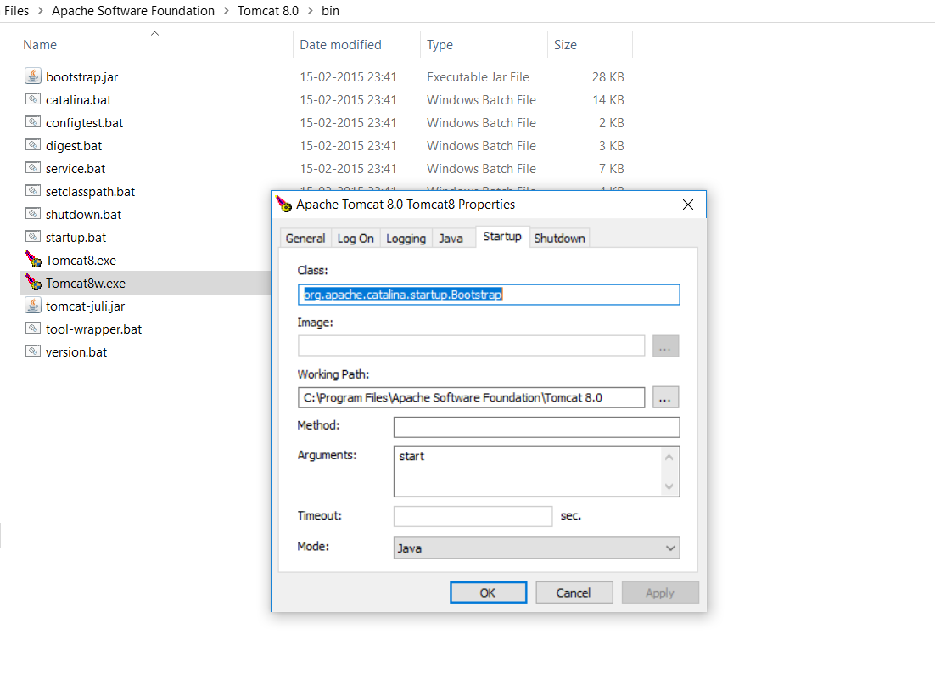

Slide 9
connectors

Slide 10
connector
The next type of element is the <Connector> element, which defines the class that does the actual handling requests and responses to and from a calling client application.
The HTTP Connector element represents a Connector component that supports the HTTP/1.1 protocol.
It enables Catalina to function as a stand-alone web server, in addition to its ability to execute servlets and JSP pages.
A particular instance of this component listens for connections on a specific TCP port number on the server.
One or more such Connectors can be configured as part of a single Service, each forwarding to the associated Engine to perform request processing and create the response.

Slide 11
connector
Attribute | Description
allowTrace | A boolean value which can be used to enable or disable the TRACE HTTP method. If not specified, this attribute is set to false.
asyncTimeout | The default timeout for asynchronous requests in milliseconds. If not specified, this attribute is set to the Servlet specification default of 30000 (30 seconds).
defaultSSLHostConfigName | The name of the default SSLHostConfig that will be used for secure connections (if this connector is configured for secure connections) if the client connection does not provide SNI or if the SNI is provided but does not match any configured SSLHostConfig. If not specified the default value of _default_ will be used.
enableLookups | Set to true if you want calls to request.getRemoteHost() to perform DNS lookups in order to return the actual host name of the remote client. Set to false to skip the DNS lookup and return the IP address in String form instead (thereby improving performance). By default, DNS lookups are disabled.
maxHeaderCount | The maximum number of headers in a request that are allowed by the container. A request that contains more headers than the specified limit will be rejected. A value of less than 0 means no limit. If not specified, a default of 100 is used.
maxParameterCount | The maximum number of parameter and value pairs (GET plus POST) which will be automatically parsed by the container. Parameter and value pairs beyond this limit will be ignored. A value of less than 0 means no limit. If not specified, a default of 10000 is used. Note that FailedRequestFilter filter can be used to reject requests that hit the limit.

Slide 12
connector
maxPostSize | The maximum size in bytes of the POST which will be handled by the container FORM URL parameter parsing. The limit can be disabled by setting this attribute to a value less than zero. If not specified, this attribute is set to 2097152 (2 megabytes). Note that the FailedRequestFilter can be used to reject requests that exceed this limit.
maxSavePostSize | The maximum size in bytes of the POST which will be saved/buffered by the container during FORM or CLIENT-CERT authentication. For both types of authentication, the POST will be saved/buffered before the user is authenticated. For CLIENT-CERT authentication, the POST is buffered for the duration of the SSL handshake and the buffer emptied when the request is processed. For FORM authentication the POST is saved whilst the user is re-directed to the login form and is retained until the user successfully authenticates or the session associated with the authentication request expires. The limit can be disabled by setting this attribute to -1. Setting the attribute to zero will disable the saving of POST data during authentication. If not specified, this attribute is set to 4096 (4 kilobytes).
parseBodyMethods | A comma-separated list of HTTP methods for which request bodies will be parsed for request parameters identically to POST. This is useful in RESTful applications that want to support POST-style semantics for PUT requests. Note that any setting other than POST causes Tomcat to behave in a way that goes against the intent of the servlet specification. The HTTP method TRACE is specifically forbidden here in accordance with the HTTP specification. The default is POST
port | The TCP port number on which this Connector will create a server socket and await incoming connections. Your operating system will allow only one server application to listen to a particular port number on a particular IP address. If the special value of 0 (zero) is used, then Tomcat will select a free port at random to use for this connector. This is typically only useful in embedded and testing applications.

Slide 13
connector
protocol | Sets the protocol to handle incoming traffic. The default value is HTTP/1.1 which uses an auto-switching mechanism to select either a Java NIO based connector or an APR/native based connector. If the PATH (Windows) or LD_LIBRARY_PATH (on most unix systems) environment variables contain the Tomcat native library, and the AprLifecycleListener that is used to initialize APR has its useAprConnector attribute set to true, the APR/native connector will be used. If the native library cannot be found or the attribute is not configured, the Java NIO based connector will be used. Note that the APR/native connector has different settings for HTTPS than the Java connectors. To use an explicit protocol rather than rely on the auto-switching mechanism described above, the following values may be used: org.apache.coyote.http11.Http11NioProtocol - non blocking Java NIO connector org.apache.coyote.http11.Http11Nio2Protocol - non blocking Java NIO2 connector org.apache.coyote.http11.Http11AprProtocol - the APR/native connector. Custom implementations may also be used.
proxyName | If this Connector is being used in a proxy configuration, configure this attribute to specify the server name to be returned for calls to request.getServerName().
proxyPort | If this Connector is being used in a proxy configuration, configure this attribute to specify the server port to be returned for calls to request.getServerPort().
redirectPort | If this Connector is supporting non-SSL requests, and a request is received for which a matching <security-constraint> requires SSL transport, Catalina will automatically redirect the request to the port number specified here.
scheme | Set this attribute to the name of the protocol you wish to have returned by calls to request.getScheme(). For example, you would set this attribute to "https" for an SSL Connector. The default value is "http".

Slide 14
connector
secure | Set this attribute to true if you wish to have calls to request.isSecure() to return true for requests received by this Connector. You would want this on an SSL Connector or a non SSL connector that is receiving data from a SSL accelerator, like a crypto card, a SSL appliance or even a webserver. The default value is false.
URIEncoding | This specifies the character encoding used to decode the URI bytes, after %xx decoding the URL. If not specified, UTF-8 will be used unless the org.apache.catalina.STRICT_SERVLET_COMPLIANCE system property is set to true in which case ISO-8859-1 will be used.
useBodyEncodingForURI | This specifies if the encoding specified in contentType should be used for URI query parameters, instead of using the URIEncoding. This setting is present for compatibility with Tomcat 4.1.x, where the encoding specified in the contentType, or explicitly set using Request.setCharacterEncoding method was also used for the parameters from the URL. The default value is false. Notes: 1) This setting is applied only to the query string of a request. Unlike URIEncoding it does not affect the path portion of a request URI. 2) If request character encoding is not known (is not provided by a browser and is not set by SetCharacterEncodingFilter or a similar filter using Request.setCharacterEncoding method), the default encoding is always "ISO-8859-1". The URIEncoding setting has no effect on this default.
useIPVHosts | Set this attribute to true to cause Tomcat to use the IP address that the request was received on to determine the Host to send the request to. The default value is false.
xpoweredBy | Set this attribute to true to cause Tomcat to advertise support for the Servlet specification using the header recommended in the specification. The default value is false.

Slide 15
connector
Java Nio Connector NIO | Java Nio2 Connector NIO2 | APR/native Connector APR
Classname | Http11NioProtocol | Http11Nio2Protocol | Http11AprProtocol
Tomcat Version | 6.x onwards | 8.x onwards | 5.5.x onwards
Support Polling | YES | YES | YES
Polling Size | maxConnections | maxConnections | maxConnections
Read Request Headers | Non Blocking | Non Blocking | Non Blocking
Read Request Body | Blocking | Blocking | Blocking
Write Response Headers and Body | Blocking | Blocking | Blocking
Wait for next Request | Non Blocking | Non Blocking | Non Blocking
SSL Support | Java SSL or OpenSSL | Java SSL or OpenSSL | OpenSSL
SSL Handshake | Non blocking | Non blocking | Blocking
Max Connections | maxConnections | maxConnections | maxConnections

Slide 16
Connector
The HTTP Upgrade Protocol element represents an Upgrade Protocol component that supports the HTTP/2 protocol.
An instance of this component must be associated with an existing HTTP/1.1 Connector.
HTTP/2 connectors use non-blocking I/O, only utilising a container thread from the thread pool when there is data to read and write.
However, because the Servlet API is fundamentally blocking, each HTTP/2 stream requires a dedicated container thread for the duration of that stream.

Slide 17
Connector
Attribute | Description
allowedTrailerHeaders | By default Tomcat will ignore all trailer headers when processing HTTP/2 connections. For a header to be processed, it must be added to this comma-separated list of header names.
initialWindowSize | Controls the initial size of the flow control window for streams that Tomcat advertises to clients. If not specified, the default value of 65535 is used.
keepAliveTimeout | The time, in milliseconds, that Tomcat will wait between HTTP/2 frames before closing the connection. Negative values will be treated as an infinite timeout. If not specified, a default value of -1 will be used.
maxConcurrentStreamExecution | The controls the maximum number of streams for any one connection that can be allocated threads from the container thread pool. If more streams are active than threads are available, those streams will have to wait for a stream to become available. If not specified, the default value of 200 will be used.
maxConcurrentStreams | The controls the maximum number of active streams permitted for any one connection. If a client attempts to open more active streams than this limit, the stream will be reset with a STREAM_REFUSED error. If not specified, the default value of 200 will be used.

Slide 18
Connector
maxHeaderCount | The maximum number of headers in a request that is allowed by the container. A request that contains more headers than the specified limit will be rejected. A value of less than 0 means no limit. If not specified, a default of 100 is used.
maxHeaderSize | The maximum total size for all headers in a request that is allowed by the container. Total size for a header is calculated as the uncompressed size of the header name in bytes, plus the uncompressed size of the header value in bytes plus an HTTP/2 overhead of 3 bytes per header. A request that contains a set of headers that requires more than the specified limit will be rejected. A value of less than 0 means no limit. If not specified, a default of 8192 is used.
maxTrailerCount | The maximum number of trailer headers in a request that is allowed by the container. A request that contains more trailer headers than the specified limit will be rejected. A value of less than 0 means no limit. If not specified, a default of 100 is used.
maxTrailerSize | The maximum total size for all trailer headers in a request that is allowed by the container. Total size for a header is calculated as the uncompressed size of the header name in bytes, plus the uncompressed size of the header value in bytes plus an HTTP/2 overhead of 3 bytes per header. A request that contains a set of trailer headers that requires more than the specified limit will be rejected. A value of less than 0 means no limit. If not specified, a default of 8192 is used.

Slide 19
Connector
readTimeout | The time, in milliseconds, that Tomcat will wait for additional data when a partial HTTP/2 frame has been received. Negative values will be treated as an infinite timeout. If not specified, a default value of 10000 will be used.
writeTimeout | The time, in milliseconds, that Tomcat will wait to write additional data when an HTTP/2 frame has been partially written. Negative values will be treated as an infinite timeout. If not specified, a default value of 10000 will be used.

Slide 20
Connector
The Apache JServ Protocol (AJP) is a binary protocol that can proxy inbound requests from a web server through to an application server that sits behind the web server.
It also supports some monitoring in that the web server can ping the application server.
Web implementors typically use AJP in a load-balanced deployment where one or more front-end web servers feed requests into one or more application servers.
Sessions are redirected to the correct application server using a routing mechanism wherein each application server instance gets a name (called a route).
In this scenario the web server functions as a reverse proxy for the application server.
Lastly, AJP supports request attributes which, when populated with environment-specific settings in the reverse proxy, provides for secure communication between the reverse proxy and application server

Slide 21
Engine
The third container element is the <Engine> element.
Each defined <Service> can have only one <Engine> element, and this single <Engine> component handles all requests received by all of the defined <Connector> components defined by a parent service.
The Engine element represents the entire request processing machinery associated with a particular Catalina Service.
It receives and processes all requests from one or more Connectors, and returns the completed response to the Connector for ultimate transmission back to the client.

Slide 22
Engine
Attribute | Description
backgroundProcessorDelay | This value represents the delay in seconds between the invocation of the backgroundProcess method on this engine and its child containers, including all hosts and contexts. Child containers will not be invoked if their delay value is not negative (which would mean they are using their own processing thread). Setting this to a positive value will cause a thread to be spawn. After waiting the specified amount of time, the thread will invoke the backgroundProcess method on this engine and all its child containers. If not specified, the default value for this attribute is 10, which represent a 10 seconds delay.
className | Java class name of the implementation to use. This class must implement the org.apache.catalina.Engine interface. If not specified, the standard value (defined below) will be used.
defaultHost | The default host name, which identifies the Host that will process requests directed to host names on this server, but which are not configured in this configuration file. This name MUST match the name attributes of one of the Host elements nested immediately inside.

Slide 23
Engine
jvmRoute | Identifier which must be used in load balancing scenarios to enable session affinity. The identifier, which must be unique across all Tomcat servers which participate in the cluster, will be appended to the generated session identifier, therefore allowing the front end proxy to always forward a particular session to the same Tomcat instance. Note that the jvmRoute can also be set using the jvmRoute system property. The jvmRoute set in an <Engine> attribute will override any jvmRoute system property.
name | Logical name of this Engine, used in log and error messages. When using multipleService elements in the same Server, each Engine MUST be assigned a unique name.
startStopThreads | The number of threads this Engine will use to start child Host elements in parallel. The special value of 0 will result in the value ofRuntime.getRuntime().availableProcessors() being used. Negative values will result in Runtime.getRuntime().availableProcessors() + value being used unless this is less than 1 in which case 1 thread will be used. If not specified, the default value of 1 will be used.

Slide 24
host
The <Host> element defines the virtual hosts that are contained in each instance of a Catalina <Engine>.
Each <Host> can be a parent to one or more web applications, with each being represented by a <Context> component
The Host element represents a virtual host, which is an association of a network name for a server (such as "www.mycompany.com") with the particular server on which Tomcat is running.
For clients to be able to connect to a Tomcat server using its network name, this name must be registered in the Domain Name Service (DNS) server that manages the Internet domain you belong to - contact your Network Administrator for more information.

Slide 25
The Realm Component
A Realm element represents a "database" of usernames, passwords, and roles (similar to Unix groups) assigned to those users.
Different implementations of Realm allow Catalina to be integrated into environments where such authentication information is already being created and maintained.

Slide 26
context
The <Context> element is the most commonly used container in a Tomcat instance. Each <Context> element represents an individual web application that is running within a defined <Host>.
There is no limit to the number of contexts that can be defined within a <Host>.

Slide 27
Tomcat versions
Tomcat version | Servlet | JSP | EL | WebSocket | Minimum Java version required
3.3.x | 2.2 | 1.1 | – | – | 1.1
4.1.x | 2.3 | 1.2 | – | – | 1.3
5.5.x | 2.4 | 2.0 | – | – | 1.4
6.0.x | 2.5 | 2.1 | 2.1 | – | 5.0
7.0.x | 3.0 | 2.2 | 2.2 | – | 6
8.0.x | 3.1 | 2.3 | 3.0 | 1.0 | 7

Slide 28
Tomcat licensing
WHERE CAN I FIND THE APACHE LICENSE
See the following links; 2.0 is the current version while 1.1 and 1.0 are older versions that the ASF no longer use:
Apache License 2.0: http://www.apache.org/licenses/LICENSE-2.0.txt
Apache Software License 1.1: http://www.apache.org/licenses/LICENSE-1.1.txt
Apache Software License 1.0: http://www.apache.org/licenses/LICENSE-1.0.txt

Slide 29
Tomcat licensing
I'M NOT A LAWYER. WHAT DOES IT ALL MEAN?
It allows you to:
freely download and use Apache software, in whole or in part, for personal, company internal, or commercial purposes;
use Apache software in packages or distributions that you create.
It forbids you to:
redistribute any piece of Apache-originated software without proper attribution;
use any marks owned by The Apache Software Foundation in any way that might state or imply that the Foundation endorses your distribution;
use any marks owned by The Apache Software Foundation in any way that might state or imply that you created the Apache software in question.

Slide 30
Tomcat licensing
I'M NOT A LAWYER. WHAT DOES IT ALL MEAN?
It requires you to:
include a copy of the license in any redistribution you may make that includes Apache software;
provide clear attribution to The Apache Software Foundation for any distributions that include Apache software.
It does not require you to:
include the source of the Apache software itself, or of any modifications you may have made to it, in any redistribution you may assemble that includes it;
submit changes that you make to the software back to the Apache Software Foundation (though such feedback is encouraged).

Slide 31
Tomcat licensing
IF I'M USING APACHE SOFTWARE CAN I SIMPLY ADHERE TO THE APACHE LICENSE 2.0, OR DO I HAVE TO ALSO ADHERE TO THE APACHE SOFTWARE LICENSE VERSIONS 1.0 AND 1.1?
It depends entirely on which versions of our software you are talking about - you should adhere to the version of our license that covered the software in question.
It should be exceedingly rare to come across version 1.0, and all active products should have had a version released under the Apache License 2.0. Feel free to contact the relevant project if you are unable to find an AL 2.0 version of their software.

Slide 32
Tomcat licensing
WHY ARE THE LICENSE FILES FOR THE DIFFERENT APACHE SOFTWARE FOUNDATION PROJECTS DIFFERENT?
While the core Apache developed code will be under one of the Apache licenses, other third party works may have been included and their license text may have been added to the Apache projects' LICENSE or NOTICE files. Alternatively, they may be available separately.

Slide 33
Tomcat licensing
IS SOFTWARE FROM THE APACHE SOFTWARE FOUNDATION FREE OF CHARGE?
Yes. All software developed by all projects of The Apache Software Foundation is freely available without charge from the Foundation's Web sites. This is specified in the Foundation's Articles of Incorporation
IS THERE A FEE FOR USING APACHE SOFTWARE IN A COMMERCIAL PRODUCT?
No. We do not distinguish between personal, internal, or commercial use of our software, nor does the ASF charge for any of them. Packaging and redistribution of any of it is subject to the terms of our license , however.
MAY I LICENSE MY OWN SOFTWARE UNDER THE APACHE LICENSE?¶
Certainly. Version 2.0 of the license was designed to be reusable, and often has been reused by parties other than the ASF.

Slide 34
Tomcat licensing
MAY I TRANSLATE THE APACHE LICENSE INTO MY LOCAL
LANGUAGE FOR MY REDISTRIBUTION OF APACHE PACKAGES?
Yes, you may translate the license text into your local language. However , any such translated text is only for the convenience of understanding, and is not legally binding. Only the English-language version of the license, which you must continue to include in your packaging , is authoritative and applicable in case legal interpretation is required.
IS THE APACHE LICENSE COMPATIBLE WITH THE GPL (GNU PUBLIC LICENSE)?
From the Free Software Foundation website:
Apache License, Version 2.0
This is a free software license, compatible with version 3 of the GPL. Please note that this license is not compatible with GPL version 2, because it has some requirements that are not in that older version. These include certain patent termination and indemnification provisions.

Slide 35
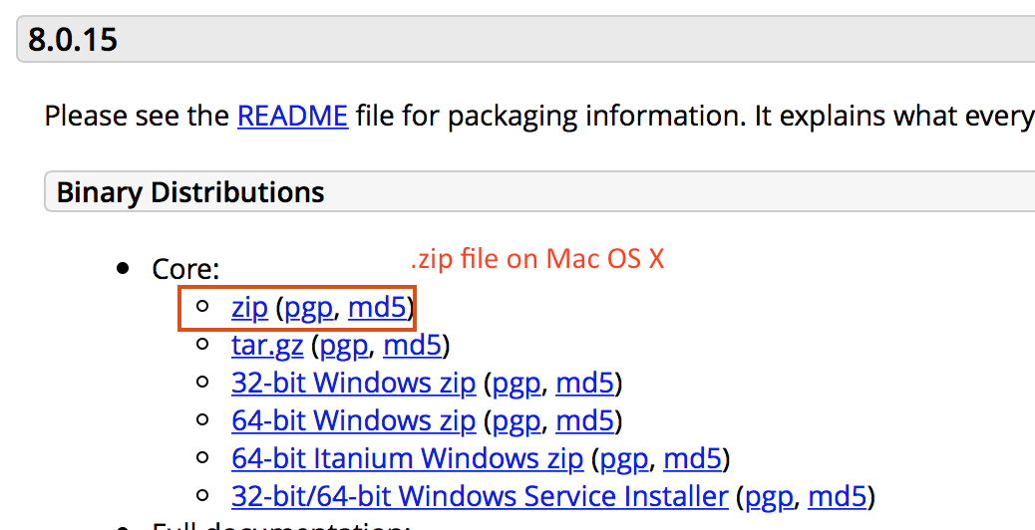
Installation directory

Slide 36
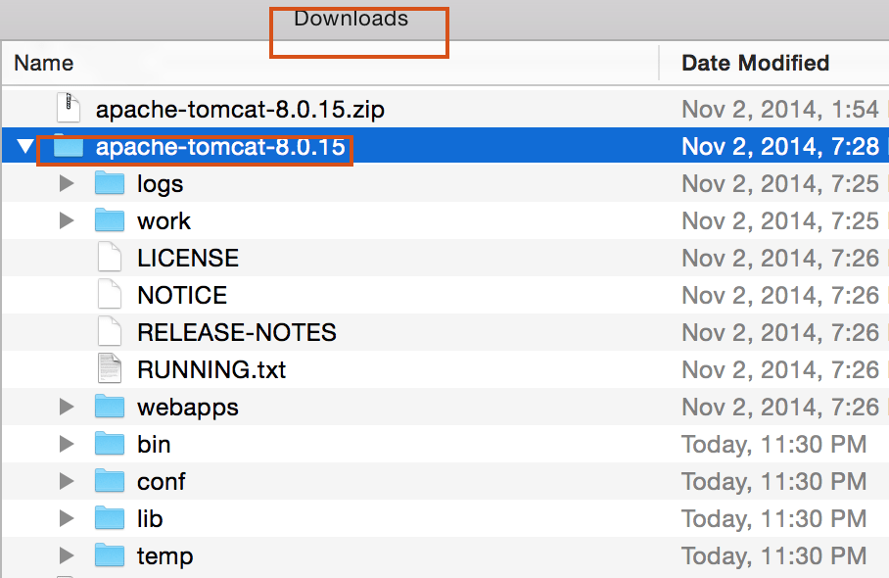
Installation directory

Slide 37
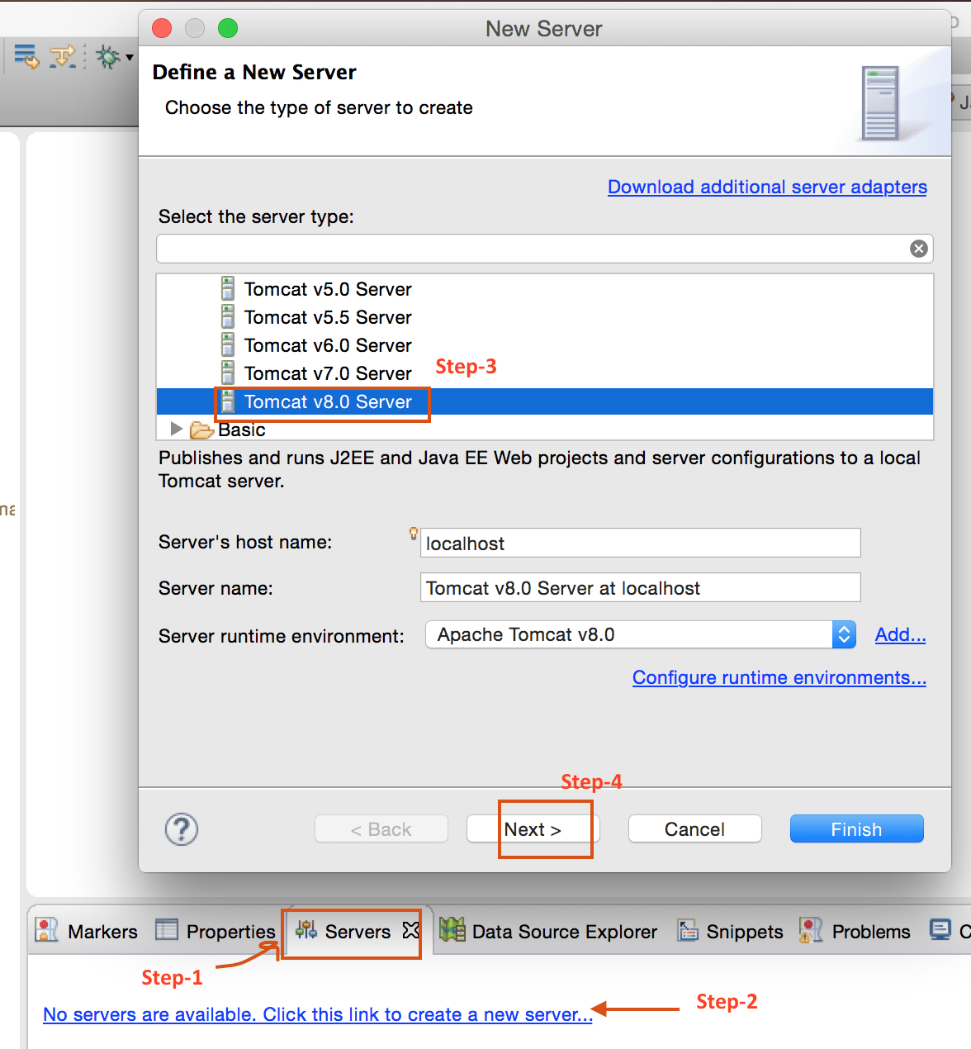
Installation directory

Slide 38
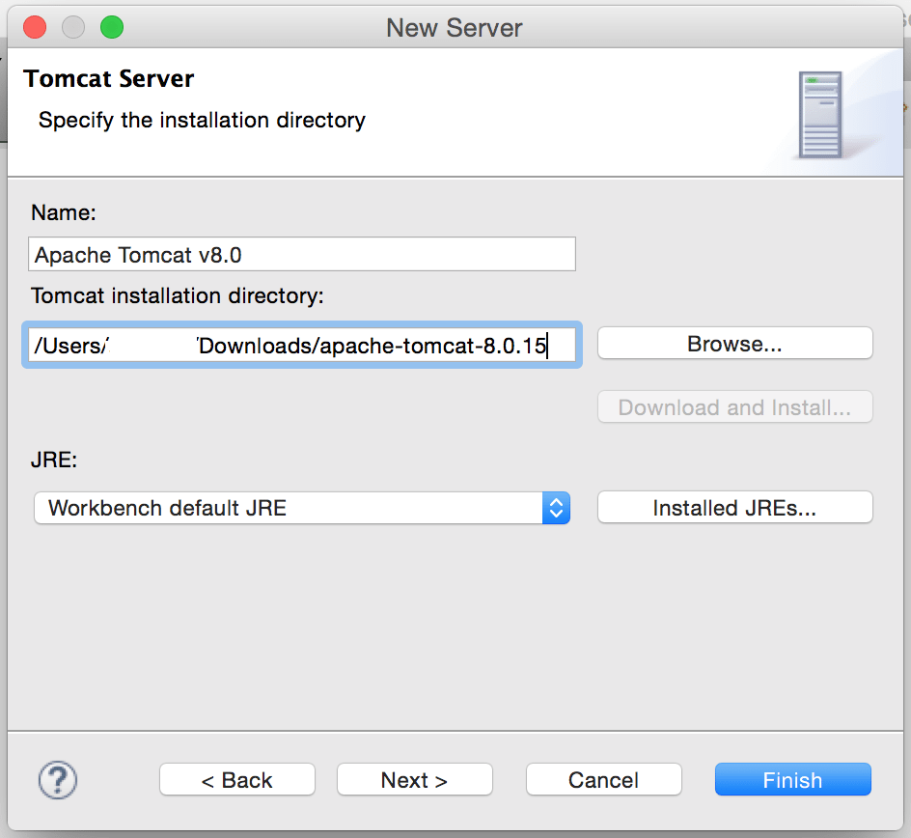
Installation directory

Slide 39
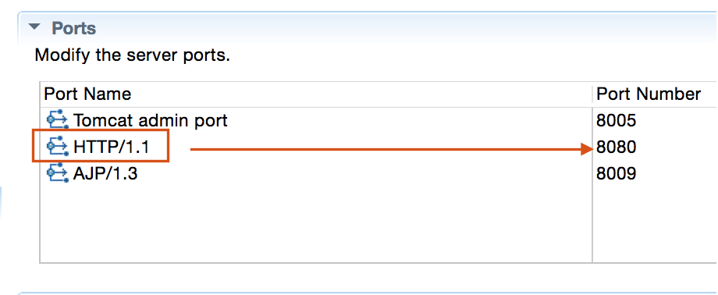
Installation directory

Slide 40
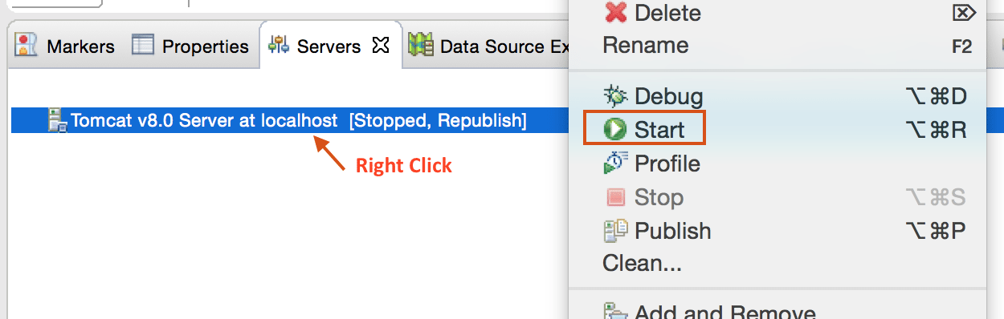
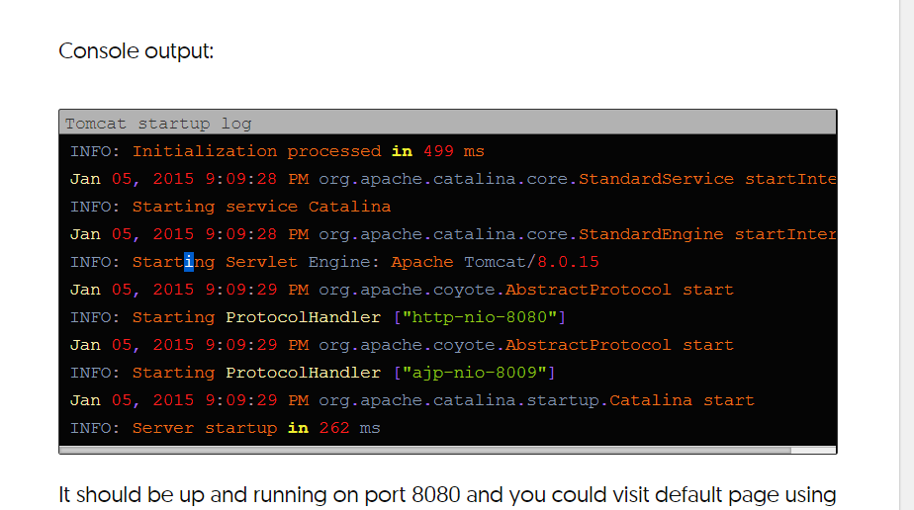
Installation directory

Slide 41
Tomcat Directory Structure
bin/
Contains startup.sh, shutdown.sh and other scripts/programs.
The *.sh files (for Unix systems) are functional duplicates of the *.bat files (for Windows systems).
conf/
Server-wide Tomcat configuration.
You will modify server.xml and tomcat-users.xml to adjust logging, authentication and access control, enable SSL, etc.
Web applications can override some server-wide settings in their own configuration files (more about that later).

Slide 42
Tomcat Directory Structure
webapps/
Contains web applications directories and WAR files. This is where we will be putting the TDS web application. You will also be using the manager application that comes with Tomcat during this workshop.
logs/
Tomcat log files are here by default.
This is one of the directories you will be looking for log files (the TDS logs elsewhere by default).
The log files should be your first stop for troubleshooting Tomcat and TDS issues. (Hint, hint.)
Logs files may contain useful information for assessing the security of your system.
You will become very familiar with the Tomcat-generated catalina.out, catalina.yyyy-mm-dd.log, and localhost_access_log.yyyy-mm-dd.log files by the end of this workshop.

Slide 43
Tomcat Directory Structure
/lib
Contains the Tomcat Java Archive (jar) files, shared across all Tomcat components.
All web applications deployed to Tomcat can access the libraries stored here.
This includes the Servlet API and JSP API libraries.
/logs Contains Tomcat’s log files.
/temp Temporary file system storag

Slide 44
Tomcat Directory Structure
$ cd apache-tomcat-8.0.24
$ ls -l
drwxr-xr-x 2 tds workshop 4096 Jul 15 09:37 bin
drwxr-xr-x 2 tds workshop 4096 Jul 2 01:59 conf
drwxr-xr-x 2 tds workshop 4096 Jul 15 09:37 lib
-rw-r--r-- 1 tds workshop 56812 Jul 2 01:59 LICENSE
drwxr-xr-x 2 tds workshop 4096 Jul 2 01:57 logs
-rw-r--r-- 1 tds workshop 1192 Jul 2 01:59 NOTICE
-rw-r--r-- 1 tds workshop 8826 Jul 2 01:59 RELEASE-NOTES
-rw-r--r-- 1 tds workshop 16262 Jul 2 01:59 RUNNING.txt
drwxr-xr-x 2 tds workshop 4096 Jul 15 09:37 temp
drwxr-xr-x 7 tds workshop 4096 Jul 2 01:59 webapps
drwxr-xr-x 2 tds workshop 4096 Jul 2 01:57 work

Slide 45
Works and temp directory
* work - Temporary working directories for web applications
Work stores compiled JSPs and other assets, you only need to "clean" the webapp directories under it on the rare occasions when an update to a WebApp is not picked up.
* temp - Directory used by the JVM for temporary files (java.io.tmpdir)
Temp is used to store files created using the Java File API for creating temporary files.

Slide 46
Tomcat troubleshooting
C:\Java\Apache Tomcat 8.0.27\bin>startup.bat
http://localhost:8080
echo %PATH%
Jps
The process Bootstrap is Tomcat server daemon.
C:\Java\jdk1.6.0_33\bin>jvisualvm

Slide 47
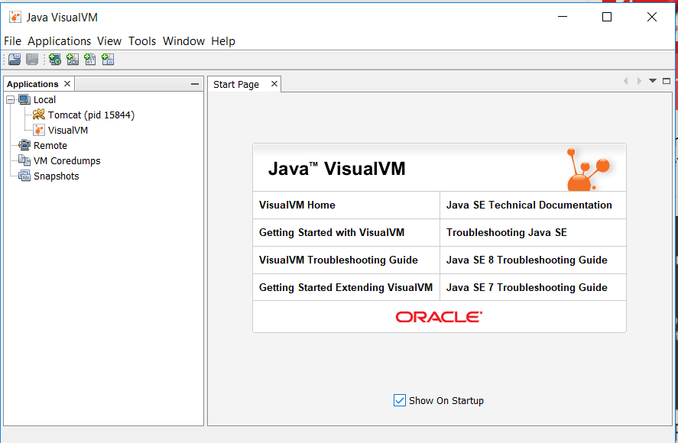
Tomcat troubleshooting

Slide 48
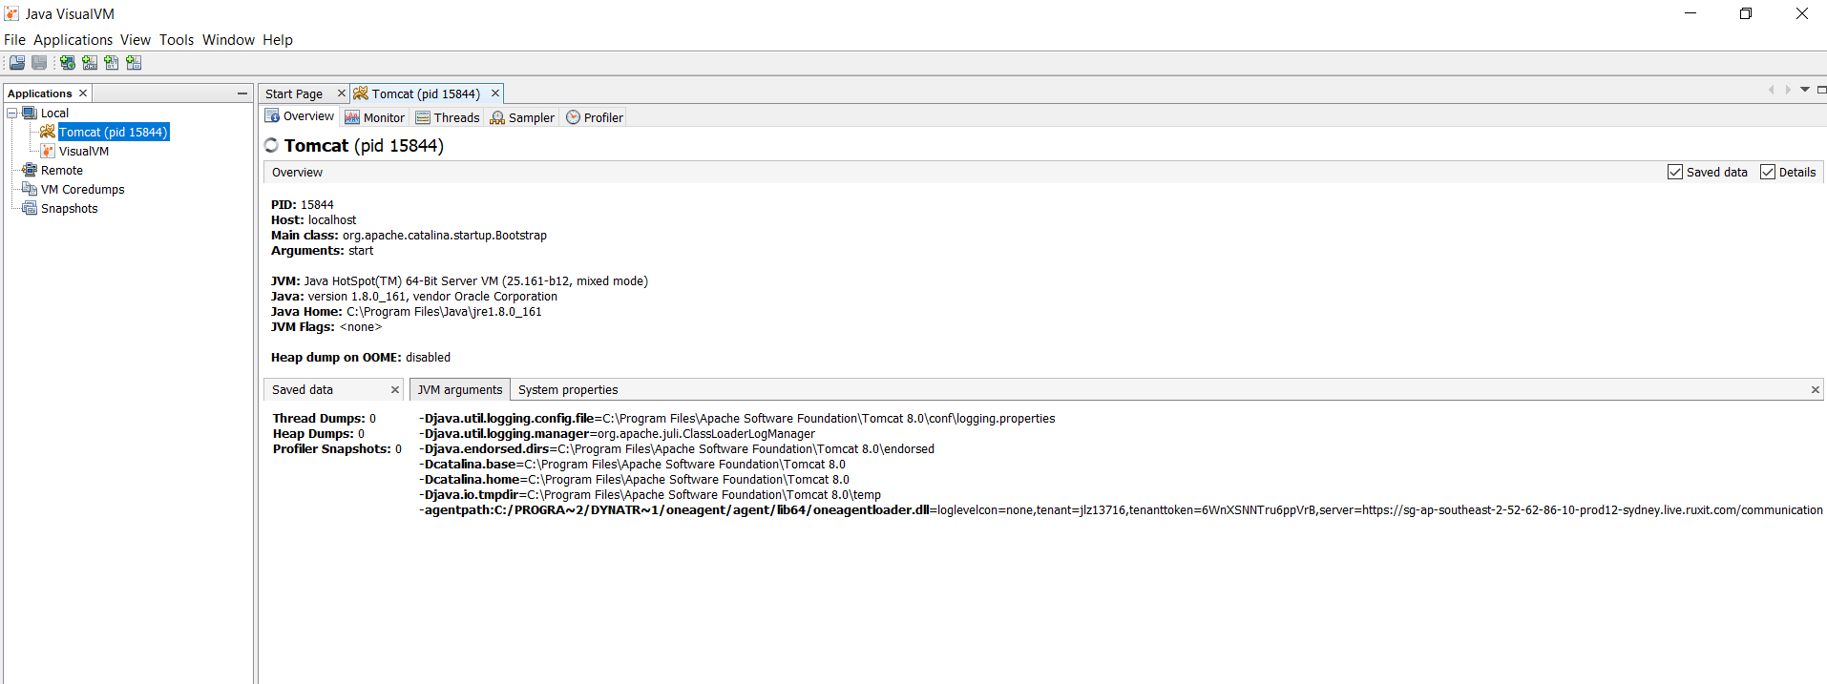
Tomcat troubleshooting
Here you can see: The PID of Tomcat. The host. The main class. The Java Home. The JVM Flags. The JVM Arguments used to launch Tomcat. And a lot of useful information about the Tomcat process.

Slide 49
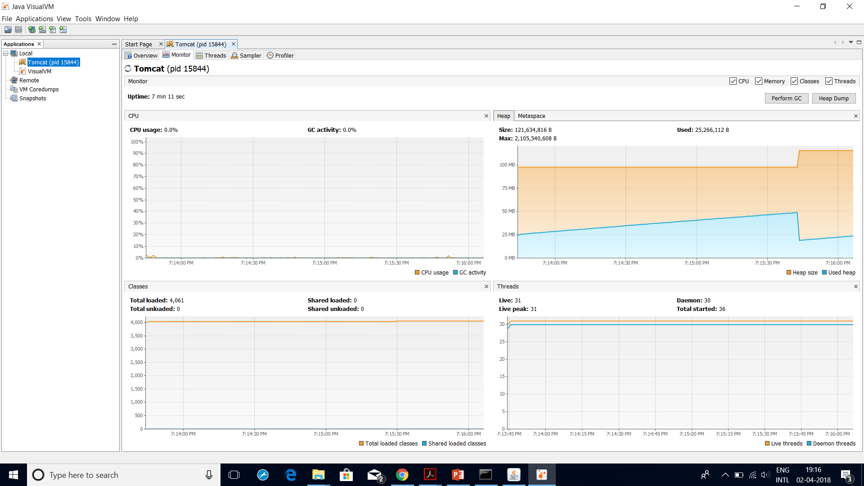
Tomcat troubleshooting

Slide 50
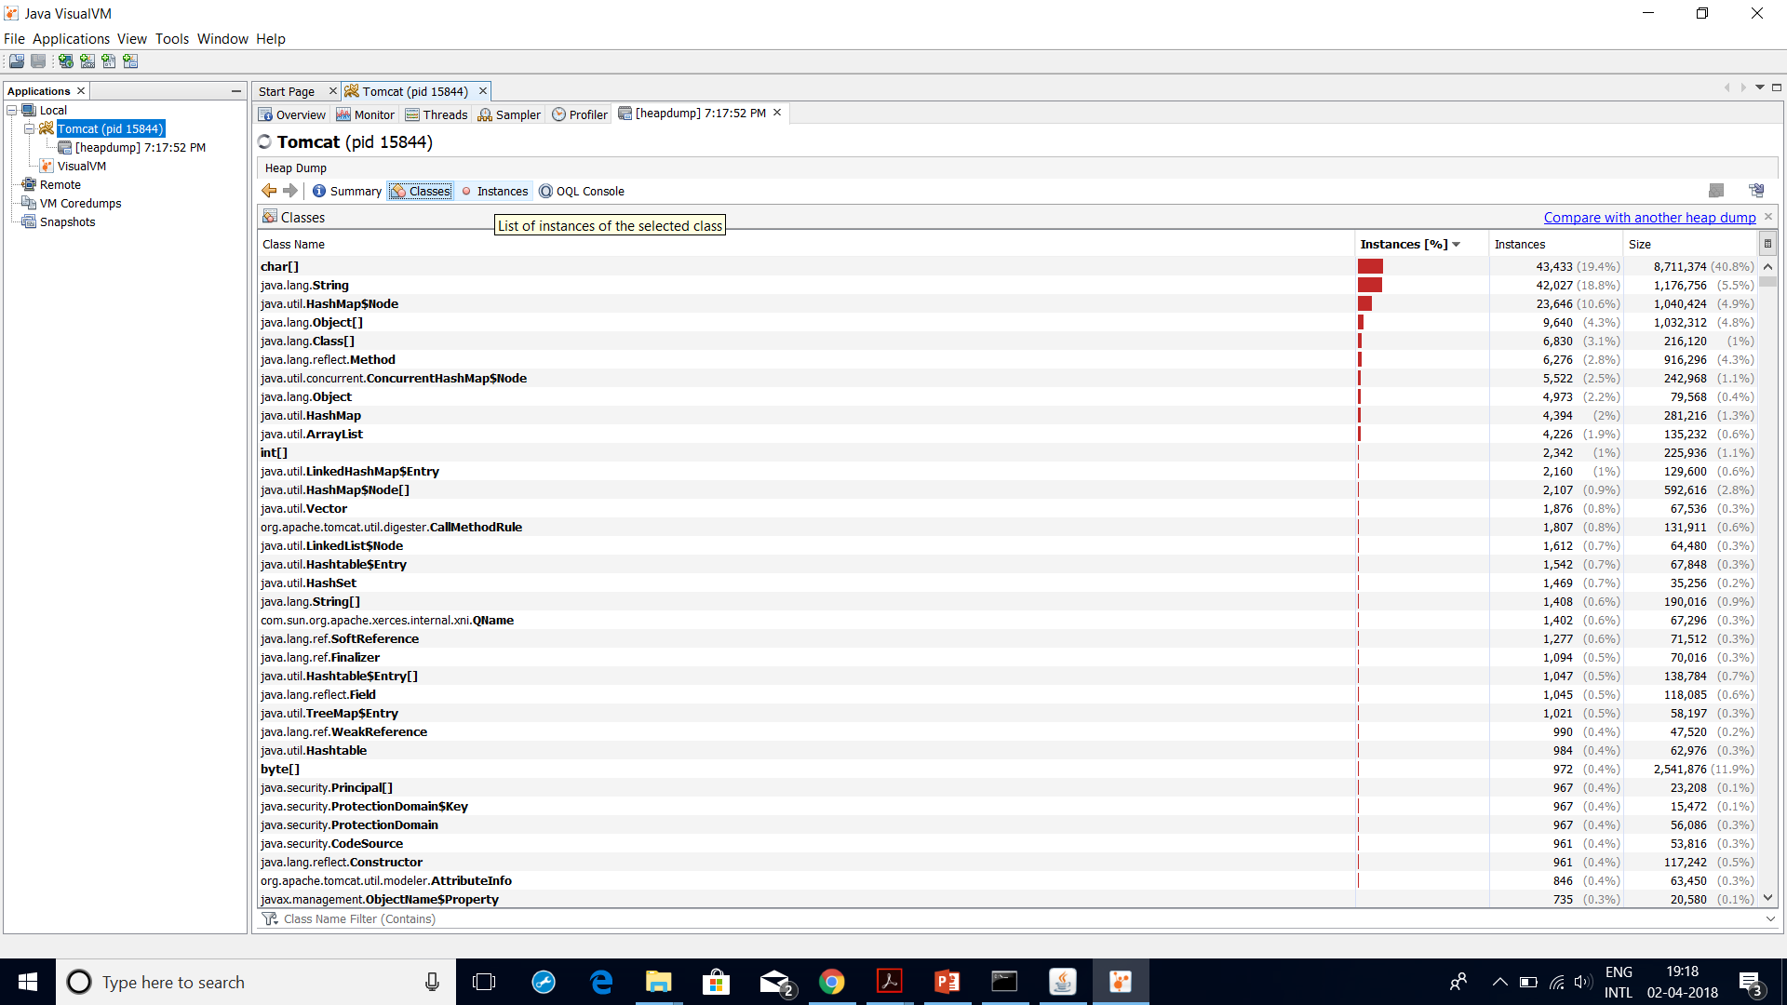
Tomcat troubleshooting
If Tomcat server crashes with an OutOfMemoryError a heap dump useful to troubleshoot these errors.

Slide 51
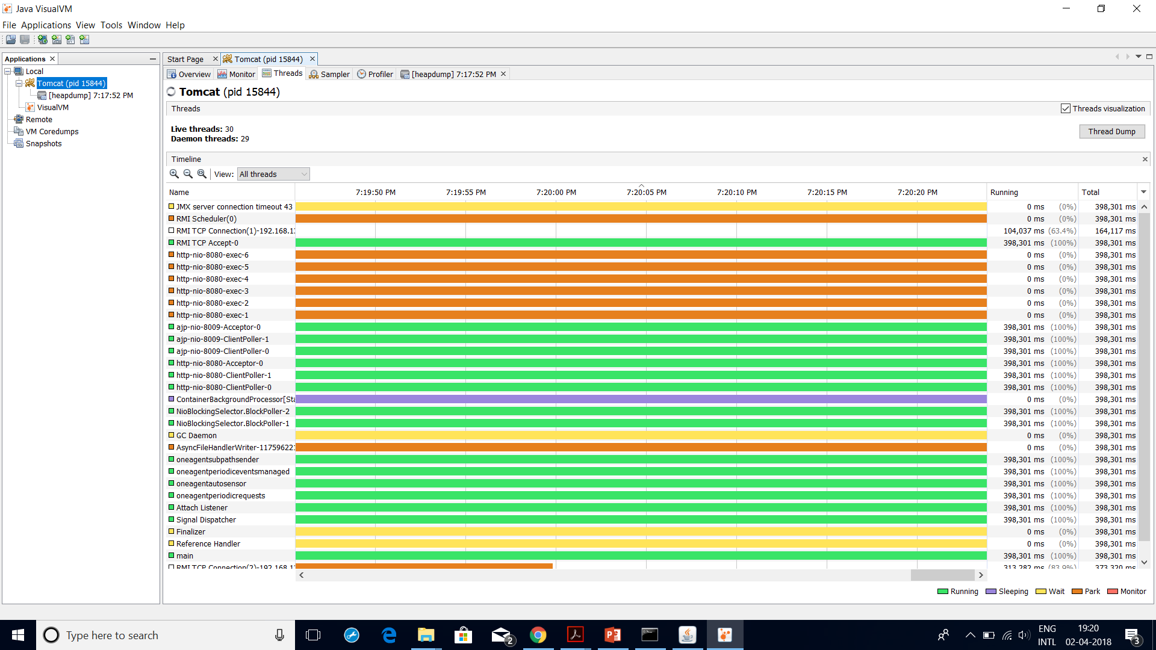
Tomcat troubleshooting

Slide 52
Errors and their solutions
JVM (memory) issues
Out of Memory exception
In an enterprise environment, out of memory issues are encountered on a regular basis due to a high memory requirement of applications and the administrator has to tune the JVM.
Failure of this causes an Out of Memory exception for the Tomcat instance.
Exception:
SEVERE: Servlet.service() for servlet jsp threw exception
java.lang.OutOfMemoryError: Java heap space

Slide 53
Errors and their solutions
JVM (memory) issues
Reason:
This error may often occur while running an application, which requires high memory-intensive resources.
Hence, it causes the Out of Memory exception on the server and leads to an interruption of services.
Solution:
You have to increase the maximum heap size for the Tomcat system.
It's important to note that you can only allocate 70 percent of physical memory as JVM memory and 30 percent is reserved for the OS.
Check the JVM configuration using the command jmap and then increase it in the configuration.

Slide 54
Errors and their solutions
You have to add the following Java parameters in the startup script of Tomcat, which can be found in TOMCAT_HOME/bin, to increase the JVM allocation based on the memory requirement and recycle the Tomcat instance.
JAVA_OPTS="-Xms512m –Xmx1048m .

Slide 55
Errors and their solutions
OutOfMemoryError: PermGen space
Tomcat administrators often face the problem with the application's permanent object generation, as every application has different requirements of object generation.
Hence, application slowness also results in the generation of OutOfMemoryError: PermGen space exception in catalina.out.
Exception:
MemoryError: PermGen space
java.lang.OutOfMemoryError: PermGen space
Reason:
The permanent generation is unique because it holds metadata describing user classes. Applications with a large code base can quickly fill up this segment of the heap which causes java.lang.OutOfMemoryError: PermGen, no matter how high your -Xmx and how much memory you have on the machine.

Slide 56
Errors and their solutions
Solution:
The following parameter should be added to the startup script of Tomcat 7. The parameter will increase the permanent generation space at the time of startup of Tomcat 7.
-XX:MaxPermSize=(MemoryValue)m
For example:
-XX:MaxPermSize=128m

Slide 57
Errors and their solutions
Stack over flow exception
This exception is mainly caused due to recursive class loading (improper coding).
This issue also causes performance degradation for the application: we observe that the application was working fine an hour ago but then it becomes unresponsive.
This is a key indication of the stack overflow exception. The following screenshot shows the error in the logs:
Exception:
at java.lang.Thread.run(Thread.java:534)
----- Root Cause -----
java.lang.StackOverflowError

Slide 58
Errors and their solutions
Reason:
The exception thrown when the execution stack overflows is because it contains too many nested method calls.
Solution:
You have to increase the value of the–xss parameter in the startup file of Tomcat.
-Xss=(memory value in k)
For example:
-Xss=128k
By default, the stack overflow exception comes with the value of 64 k followed by the recycle.

Slide 59
Errors and their solutions
Database-related issues
Broken pipe exception
The broken pipe exception is one of the most common issues reported in the production environment. What does this exception mean? It means that the database connectivity from the J2EE container is terminated. Possible causes for this issue are frequent network disconnects, Ethernet failure on the database, or the J2EE server-level container.
The following screenshot shows the error in the logs:
Exception:
at java.lang.Thread.run(Thread.java:619)
Caused by: ClientAbortException: java.net.SocketException: Broken pipe

Slide 60
Errors and their solutions
Database-related issues
Broken pipe exception
Reason:
This issue is caused due to a connectivity loss between Tomcat 7 and the database.
Solution:
Recycle the Tomcat instance to restore the connectivity.

Slide 61
Errors and their solutions
Database-related issues
Timeout waiting for an idle object
Many times, when we click on the application for any transaction, the application displays a blank page after a while.
What happens is the application server sends the request to the database and waits for the response, but the connection is abnormally terminated at the server causing a connection timeout exception. The following screenshot shows the errors in the logs:
Exception:
at org.apache.commons.dbcp.PoolingDataSource.getConnection (PoolingDataSource.java:104)
Caused by: java.util.NoSuchElementException: Timeout waiting for idle object

Slide 62
Errors and their solutions
Database-related issues
Timeout waiting for an idle object
Reason:
This issue is caused due to connection pooling for Tomcat.
Solution:
Change the connection idle values for Tomcat, these settings are in server.xml, followed by the recycle.

Slide 63
Errors and their solutions
Database-related issues
Database connectivity exception
This kind of issue is often reported in an enterprise environment, where installation of a new application is in process or the migration of an application is in process.
It's an issue with an incorrect configuration with JNDI in Tomcat 7.
Exception:
java.lang.RuntimeException: Error initializing application. Error Unable to load any specified brand or the default brand: net.project.persistence.PersistenceException: Unable to load brand from database.

Slide 64
Errors and their solutions
Database-related issues
The previous error often indicates that the database could not be accessed.
Please check your database configuration or contact your system administrator: java.sql.SQLException: Error looking up data source for name: jdbc/abc
Reason:
Tomcat 7 is unable to connect to the database due to an incorrect JNDI name or the JNDI name doesn't exist.
Solution:
Work with the database administrator to get the correct JNDI name and configure it correctly, followed by a recycle.

Slide 65
Logging
Types of logging in Tomcat

Slide 66
Logging
Types of logging in Tomcat
Application log
These logs are used to capture the application event while running the application transaction.
These logs are very useful in order to identify the application level issues.
For example, suppose your application performance is slow on a particular transition, then the details of that transition can only be traced in the application log.
The biggest advantage of application logs is we can configure separate log levels and log files for each application, making it very easy for the administrators to troubleshoot the application.

Slide 67
Logging
Types of logging in Tomcat
Server log
Server logs are identical to console logs. The only advantage of server logs is that they can be retrieved anytime, but console logs are not available after we log out from the console.

Slide 68
Logging
Types of logging in Tomcat
Console log
This log gives you the complete information of the Tomcat 8 startup and loader sequence.
The log file is named as catalina.out and is found in TOMCAT_HOME/ logs.
This log file is very useful in checking the application deployment and server startup testing for any environment.
This log is configured in the Tomcat file catalina.sh, which can be found in TOMCAT_HOME/bin.

Slide 69
Types of log levels in Tomcat
There are seven levels defined for Tomcat logging services (JULI). They can be set based on the application's requirement.
The following figure shows the sequence of the log levels for JULI:

Slide 70
Types of log levels in Tomcat

Slide 71
Types of log levels in Tomcat

Slide 72
Types of log levels in Tomcat
Values for Tomcat

Slide 73
MONITORING TOMCAT
In a real-time environment, the system may break down due to many reasons such as a network glitch, sudden CPU spike, JVM crash, and so on.
There are some revenue-generating applications, for example, if bank sites go down, then there will be a huge revenue loss, also administrators will not know unless users start complaining about the issues.
This will also have a bad impact on the business.
If monitoring systems were set up on the server, the web administrator would get a notification stating that the following systems are going down, and he/she would take the necessary actions to fix the problem.
Hence, it minimizes the impact on the application downtime.

Slide 74
Different ways of monitoring

Slide 75
Different ways of monitoring
Third-party tools
Monitoring setups are configured using third-party tools present in the market, such as Wily, SiteScope, Nagios, and so on.
These kind of monitoring tools are used in an enterprise infrastructure setup, where there are more than 100 servers with different infrastructure components (domains) such as web, application, database, filesystem servers, and so on.

Slide 76
Different ways of monitoring
Scripts
Scripts are used in monitoring, where a specific use case needs to be monitored, such as the results of how many users are logged in for a particular interval of time or application-specific user roles.
Used everywhere in small and big IT organizations.

Slide 77
Different ways of monitoring
Manual
This process is used when any application's performance is slow for a particular module.
Mostly used at the time of troubleshooting and where the number of systems are less than three.

Slide 78
Monitoring setup for a web application and database server

Slide 79
Monitoring setup for a web application and database server

Slide 80
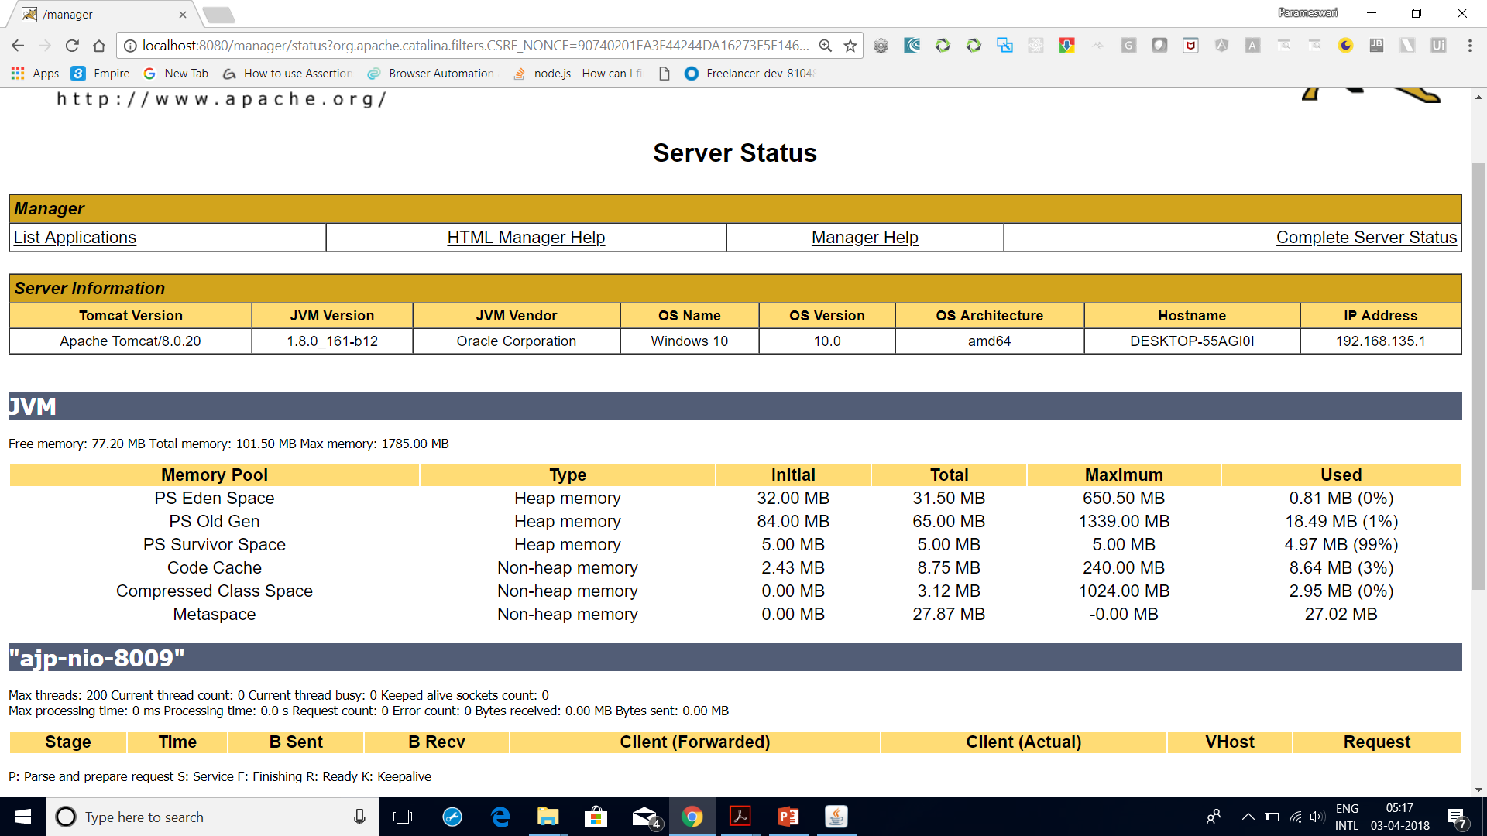
Monitoring setup for a web application and database server
http://localhost:8080/manager/status

Slide 81
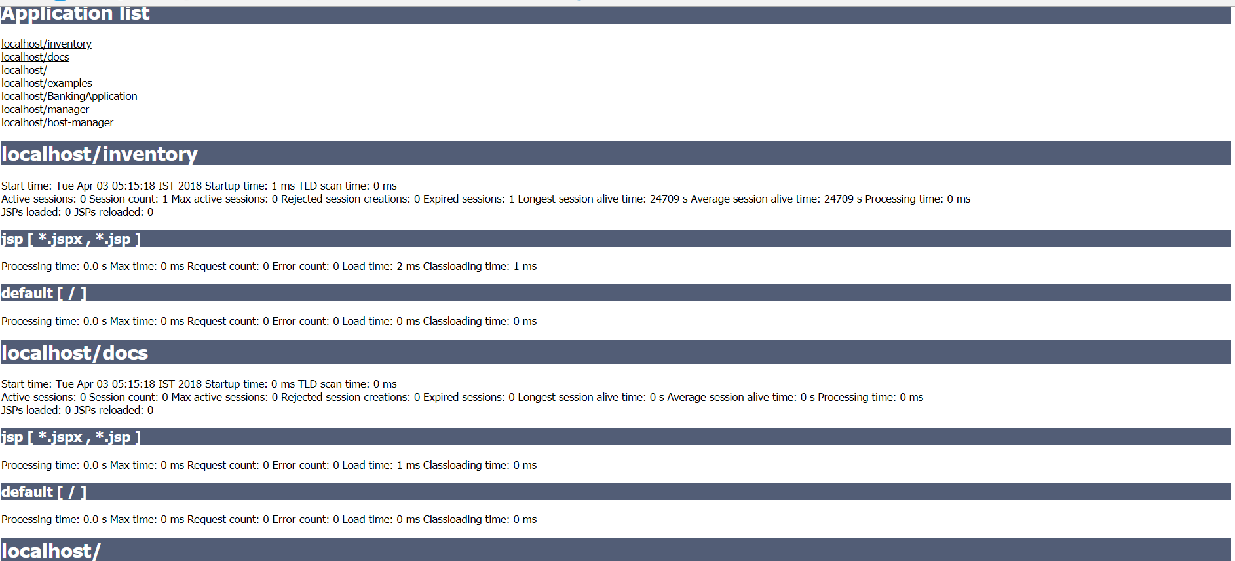
Monitoring setup for a web application and database server
http://localhost:8080/manager/status/all

Slide 82
JConsole configuration on Tomcat
JConsole is one of the best monitoring utilities that comes with JDK 1.5 or later.
The full form of the JConsole is the Java Monitoring and Management Console.
It's a graphical tool, which gives complete details of the application and server performance.
It gives us the following information about the application hosted in Tomcat
Detect low memory
• Enable or disable the GC and class loading verbose tracing
• Detect deadlocks
• Control the log level of any loggers in an application
• Access the OS resources—Sun's platform extension
• Manage an application's Managed Beans (MBeans)

Slide 83
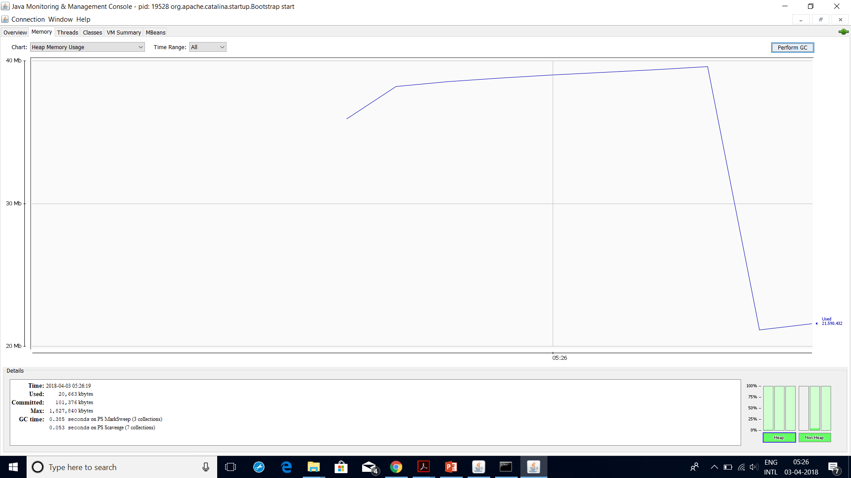

Slide 84
MBeans
This tab gives you the complete picture of Managed Beans (MBeans) deployed in the Tomcat instance.
It includes both Tomcat and application-level MBeans.
Following are the advantages of the MBeans tab:
• All parameters used in one tab
• Easy-to-deploy, rollback, and invoke
• We can create a user at the database level using MBeans
• We can create notifications for events using MBeans
• Configuration for resources can be done dynamically

Slide 85
Types of MBeans

Slide 86
Realm
DROP DATABASE IF EXISTS tomcat_realm;
CREATE DATABASE tomcat_realm;
USE tomcat_realm;
CREATE TABLE tomcat_users (
user_name varchar(20) NOT NULL PRIMARY KEY,
password varchar(32) NOT NULL
);
CREATE TABLE tomcat_roles (
role_name varchar(20) NOT NULL PRIMARY KEY
);

Slide 87
Realm
CREATE TABLE tomcat_users_roles (
user_name varchar(20) NOT NULL,
role_name varchar(20) NOT NULL,
PRIMARY KEY (user_name, role_name),
CONSTRAINT tomcat_users_roles_foreign_key_1 FOREIGN KEY (user_name) REFERENCES tomcat_users (user_name),
CONSTRAINT tomcat_users_roles_foreign_key_2 FOREIGN KEY (role_name) REFERENCES tomcat_roles (role_name)
);

Slide 88
Realm
INSERT INTO tomcat_users (user_name, password) VALUES ('deron', 'deronpass');
INSERT INTO tomcat_users (user_name, password) VALUES ('larry', 'buythecompetition');
INSERT INTO tomcat_roles (role_name) VALUES ('dude');
INSERT INTO tomcat_roles (role_name) VALUES ('manager');
INSERT INTO tomcat_users_roles (user_name, role_name) VALUES ('deron', 'dude');
INSERT INTO tomcat_users_roles (user_name, role_name) VALUES ('deron', 'manager');
INSERT INTO tomcat_users_roles (user_name, role_name) VALUES ('larry', 'dude');
COMMIT;

Slide 89
Tomcat scripting
sc query state=all |findstr “Tomcat”
Create window scripts to auto restart tomcat

Slide 90
TOMCAT SECURITY SSL
cd %JAVA_HOME%/bin
keytool -genkey -alias tomcat -keyalg RSA
loiane:bin loiane$ keytool -genkey -alias tomcat -keyalg RSA
Enter keystore password: password
Re-enter new password: password
What is your first and last name?
[Unknown]: Loiane Groner
What is the name of your organizational unit?
[Unknown]: home
What is the name of your organization?
[Unknown]: home

Slide 91
TOMCAT SECURITY SSL
What is the name of your City or Locality?
[Unknown]: Sao Paulo
What is the name of your State or Province?
[Unknown]: SP
What is the two-letter country code for this unit?
[Unknown]: BR
Is CN=Loiane Groner, OU=home, O=home, L=Sao Paulo, ST=SP, C=BR correct?
[no]: yes

Slide 92
TOMCAT SECURITY SSL
Enter key password for
(RETURN if same as keystore password): password
Re-enter new password: password
Connector SSLEnabled="true" acceptCount="100" clientAuth="false"
disableUploadTimeout="true" enableLookups="false" maxThreads="25"
port="8443" keystoreFile="/Users/loiane/.keystore" keystorePass="password"
protocol="org.apache.coyote.http11.Http11NioProtocol" scheme="https"
secure="true" sslProtocol="TLS" />

Slide 93
Unexpected shutdown
“The Service on local computer started and then stopped ,Some services stop automatically if there are not in use by other services or programs.”
1) Click Run Command from start button.
2) Enter Services.msc then click OK,you will get all the services in your computer.
3) Select your service and right click on the service and select Properties
4) Goto Logon Properties and select Local System Account then click OK.
This will work.

Slide 94
Unexpected shutdown
Scenario: Tomcat shuts down without any logs or errors
Root Cause for my problem: synchronized method accessed from a task using TimerTask
I had a singleton class with a synchronized method accessed from various threads based on timer or user action some times this method will take up to few minutes to complete.
When TimerTask is waiting on this method for sometime (I guess timer is timed out /thread is killed or something is happening in the background) and the moment the lock on the method is released the tomcat is getting killed.
So I removed synchronized keyword and removed singleton and made some code changes for thread safety. Then the problem is gone.
How I found out: I had a log statement in the first line of synchronized method and everytime the tomcat shutdowns I found this message in the last few lines.

Slide 95
Unexpected shutdown
Caused by: java.net.BindException: Address already in use: JVM_Bind
The port that Tomcat is configured to use, is already in use by another application.
Either shutdown the other application, or edit your server.xml file to use another port (the default one is 8080).

Slide 96
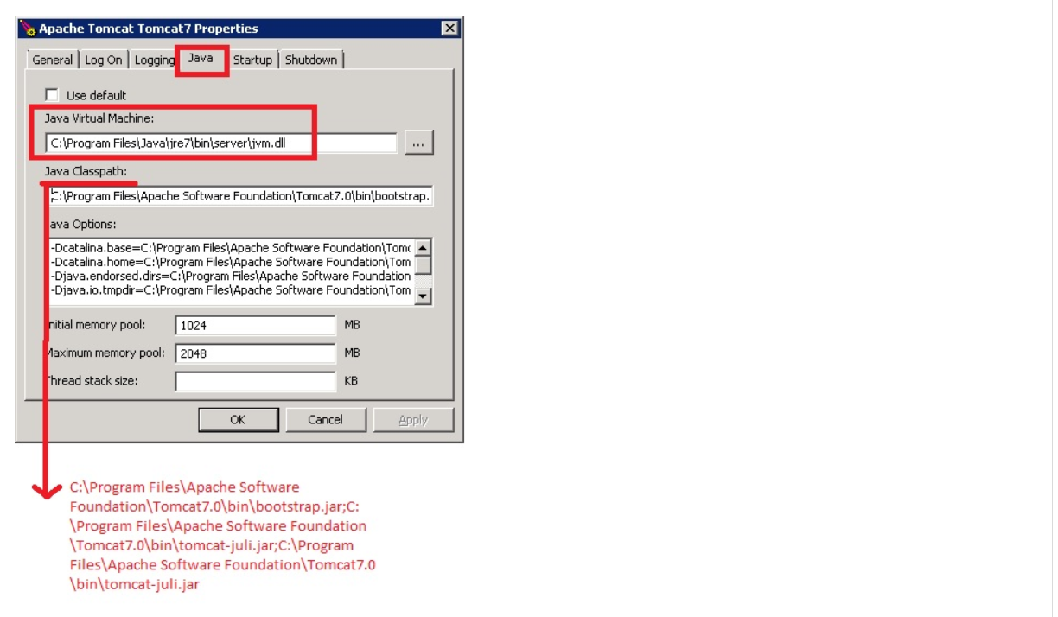
Unexpected shutdown

Slide 97
Unexpected shutdown
Regular OutOfMemoryError in the Java Heap, the error cause
You have set -Xmx too low or
You have a memory leak in your application
The reason the JVM crashes, is cause you are using a very old JVM, I suggest you
Upgrade your JVM to the latest 1.8.0 release
Use a 64 bit JVM
Increase -Xmx

Slide 98
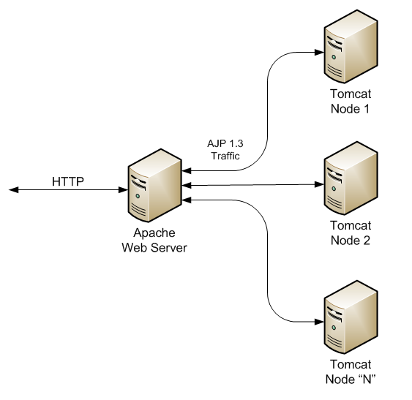
Tomcat clustering

Slide 99










Driver
Write
Primary
Read
Asynchronous Replication
Secondary
Read
Secondary
Read

Slide 100

Driver
Primary
Secondary
Read
Secondary
Read

Slide 101


Driver
Primary
Write Read
Primary
Automatic Leader Election
Secondary
Read

Slide 102





Driver
Secondary
Read Write Read
Primary
Secondary
Read

Slide 103
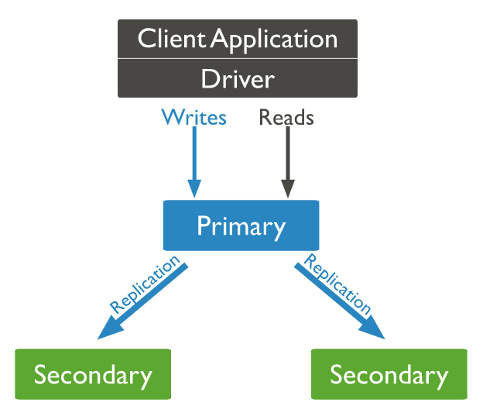

Slide 104
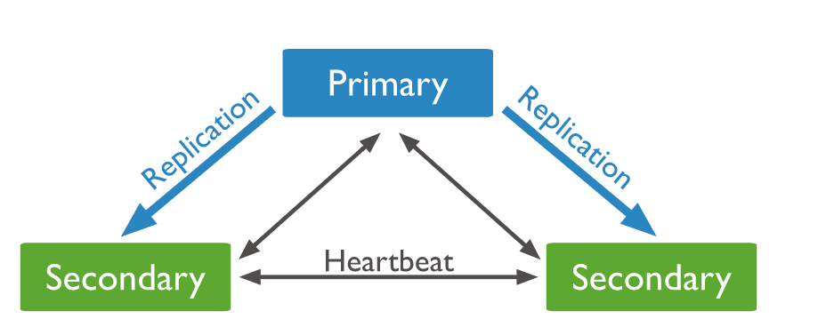

Slide 105
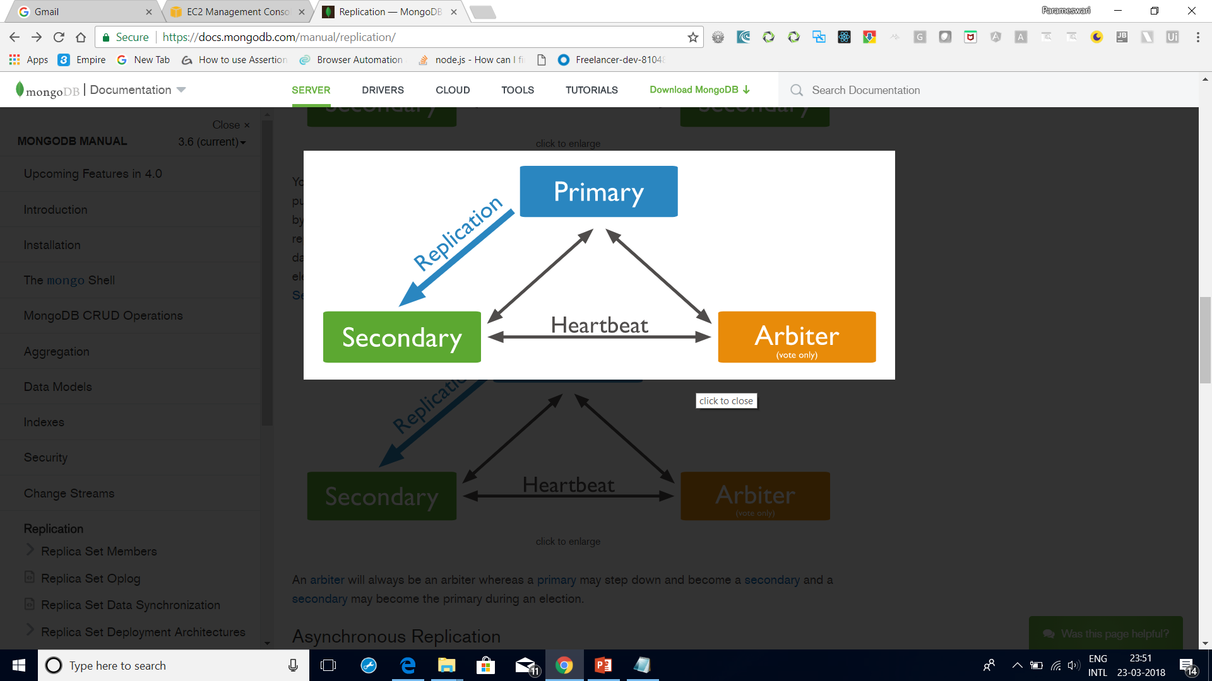
rs.addArb("m1.example.net:27017")

Slide 109
Tomcat clustering
1. Download Tomcat .ZIP distribution
2. We'll use a folder to install all this stuff in. Let's say it's "C:\cluster" for the purposes of the article.
3. Unzip the Tomcat distro twice, into two folders - C:\cluster\tomcat-node-1C:\cluster\tomcat-node-2
4. Start up each of the nodes, using the bin/startup.bat / bin/startup.sh scripts. Ensure they start. If they don't you may need to point Tomcat to the JDK installation on your machine.
5. Open up the server.xml configuration on c:\cluster\tomcat-node-1\conf\server.xml

Slide 110
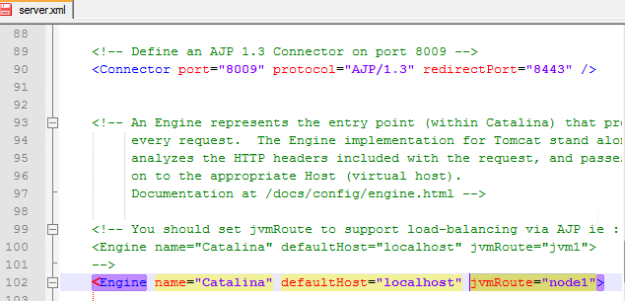
Tomcat clustering
6. There are two places we need to (potentially) configure -

Slide 111
Tomcat clustering
8. Now repeat this for C:\cluster\tomcat-node-2\conf\server.xml Change the jvmRoute to "node2" and the AJP connector port to “7070".
We're done with Tomcat. Start each node up, and ensure it still works.

Slide 112
Setting Up The Apache Cluster
1. Download and install Apache HTTP Server.
Use the custom option to install it into C:\cluster\apache2.4
2. Now open up c:\cluster\apache2.2\conf\httpd.conf in your favourite text editor.
3. Firstly, we need to uncomment the following lines (delete the '#') –
LoadModule lbmethod_byrequests_module modules/mod_lbmethod_byrequests.so
LoadModule proxy_module modules/mod_proxy.so
LoadModule proxy_balancer_module modules/mod_proxy_balancer.so
LoadModule proxy_http_module modules/mod_proxy_http.so
LoadModule slotmem_shm_module modules/mod_slotmem_shm.so

Slide 113
Setting Up The Apache Cluster
4. Finally, go to the end of the file, and add the following:
ServerName localhost
#NameVirtualHost *:72
<VirtualHost *:72>
<Proxy balancer://mycluster>
BalancerMember http://127.0.0.1:8080 min=10 max=100 route=node1 loadfactor=1
BalancerMember http://127.0.0.1:7070 min=10 max=100 route=node2 loadfactor=1
</Proxy>
ProxyPreserveHost On
ProxyPass / balancer://mycluster/
ProxyPassReverse / balancer://mycluster/
</VirtualHost>

Slide 114
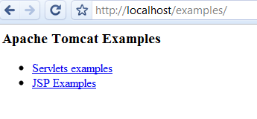
Setting Up The Apache Cluster
4. save it, and restart your Apache server.
With your Apache server running you should be able to go to http://localhost:72/examples

Slide 115
Load Balancer
1.Add the following to the bottom of your G:\Local disk\ApacheCluster\apachehttp\Apache2.4 \conf\httpd.conf
<Location /balancer-manager>
SetHandler balancer-manager
AuthType Basic
AuthName "Balancer Manager"
AuthUserFile "G:/Local disk/ApacheCluster/apachehttp/Apache2.4/conf/.htpasswd"
Require valid-user
</Location>

Slide 116
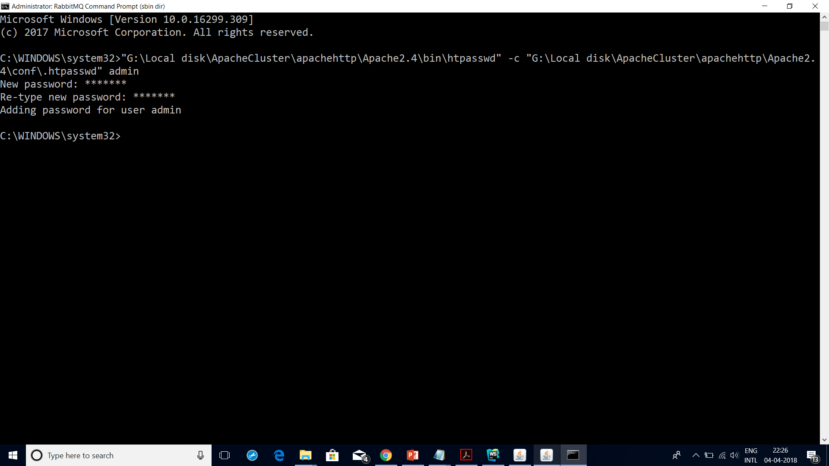
Load Balancer

Slide 117
Load Balancer
2. We need to create a password file to secure it. At the command prompt you can use
"G:\Local disk\ApacheCluster\apachehttp\Apache2.4\bin\htpasswd" -c "G:\Local disk\ApacheCluster\apachehttp\Apache2.4\conf\.htpasswd" admin
3. Restart your Apache web server, and go to http://localhost/balancer-manager

Slide 118
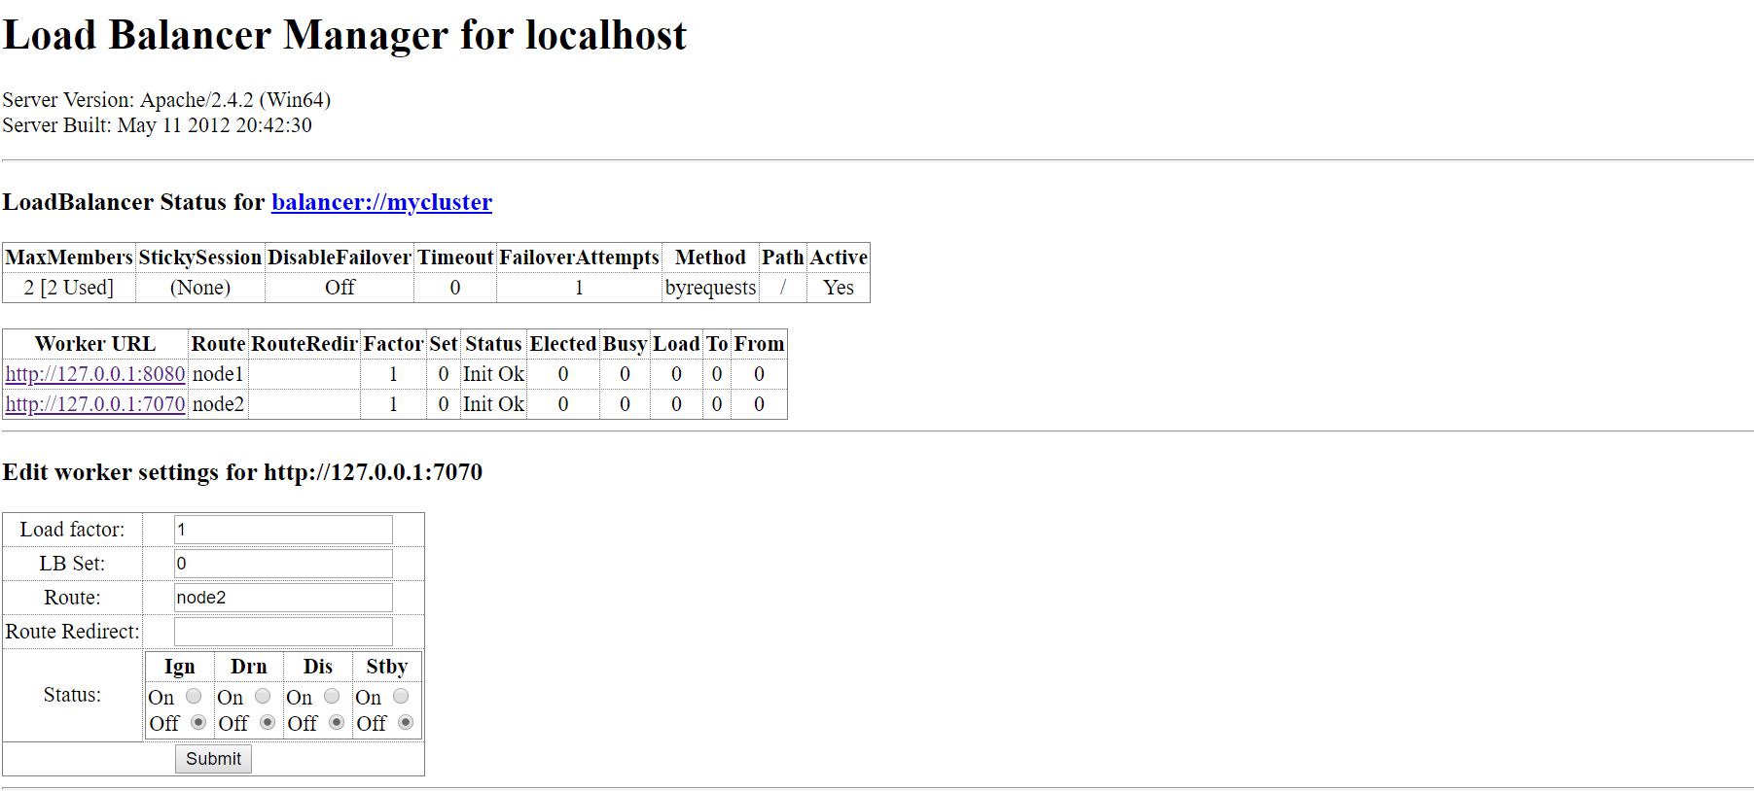

Slide 119
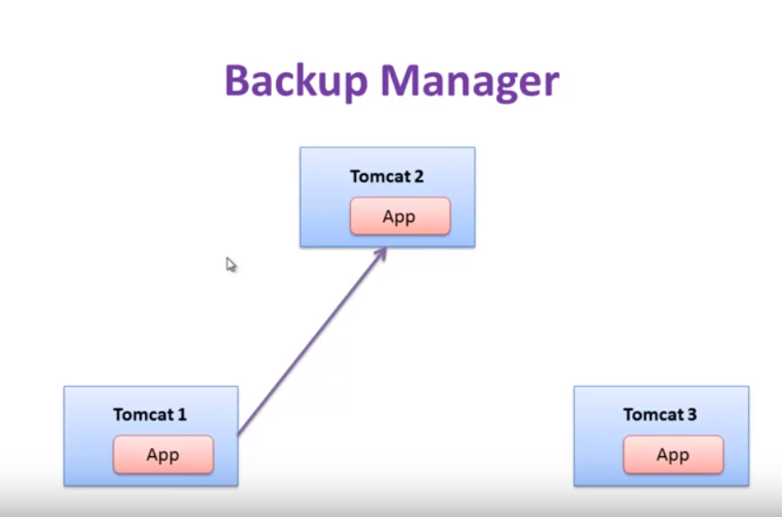
Backup Manager
Replicate exactly one copy to another instance.

Slide 120
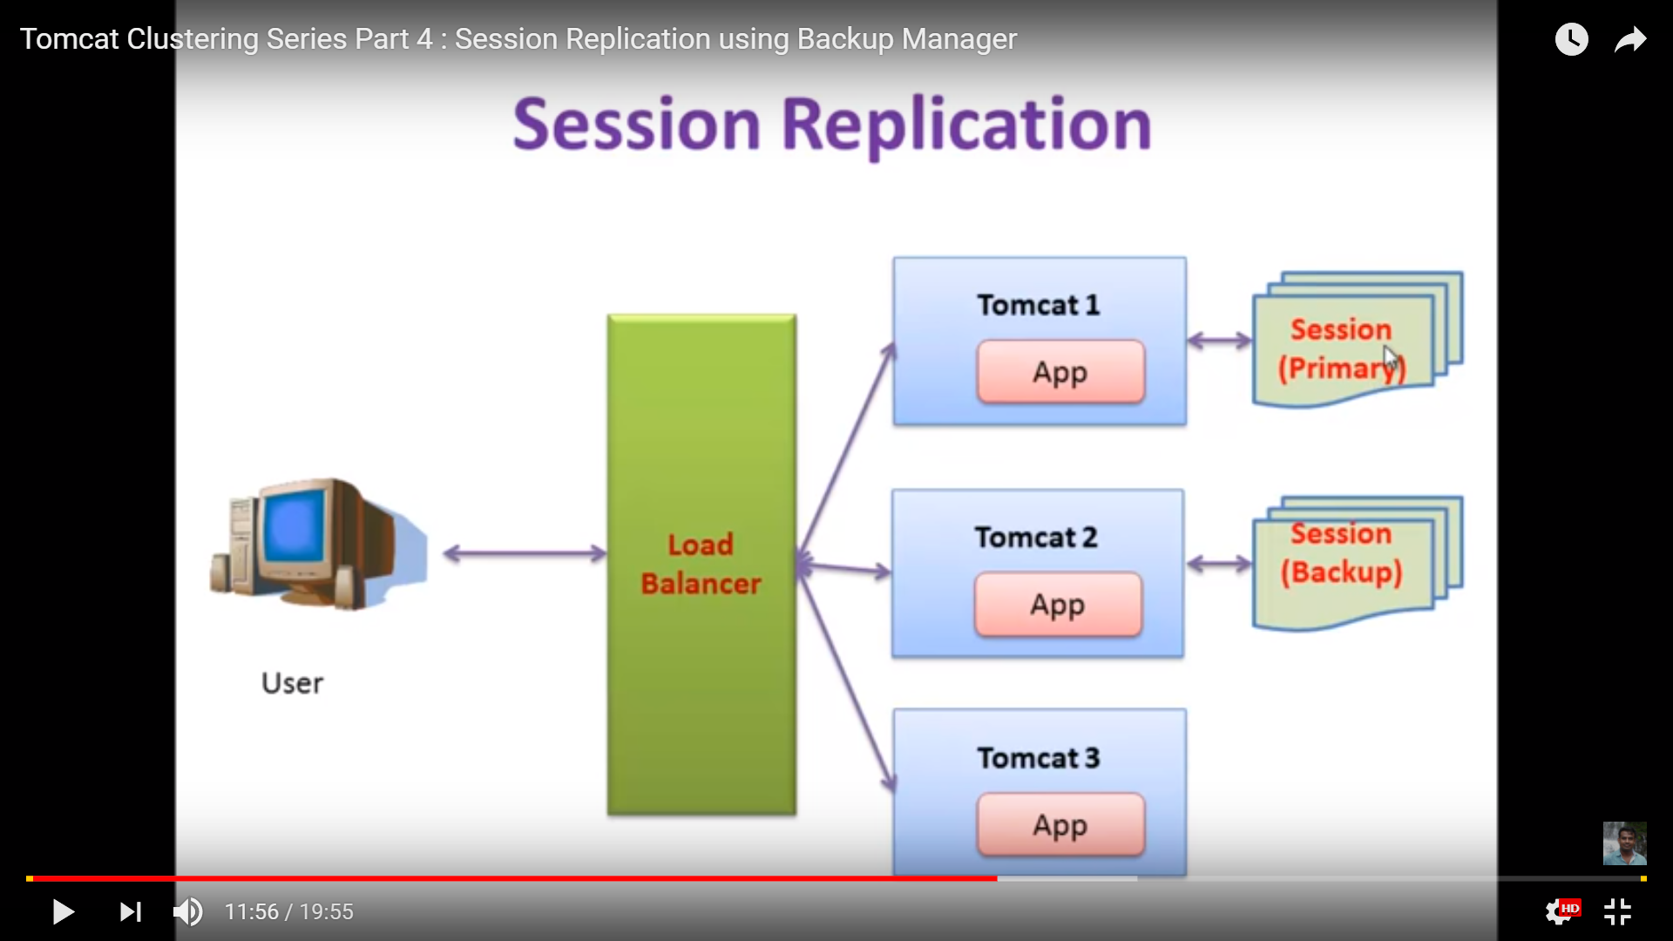
Backup Manager

Slide 121
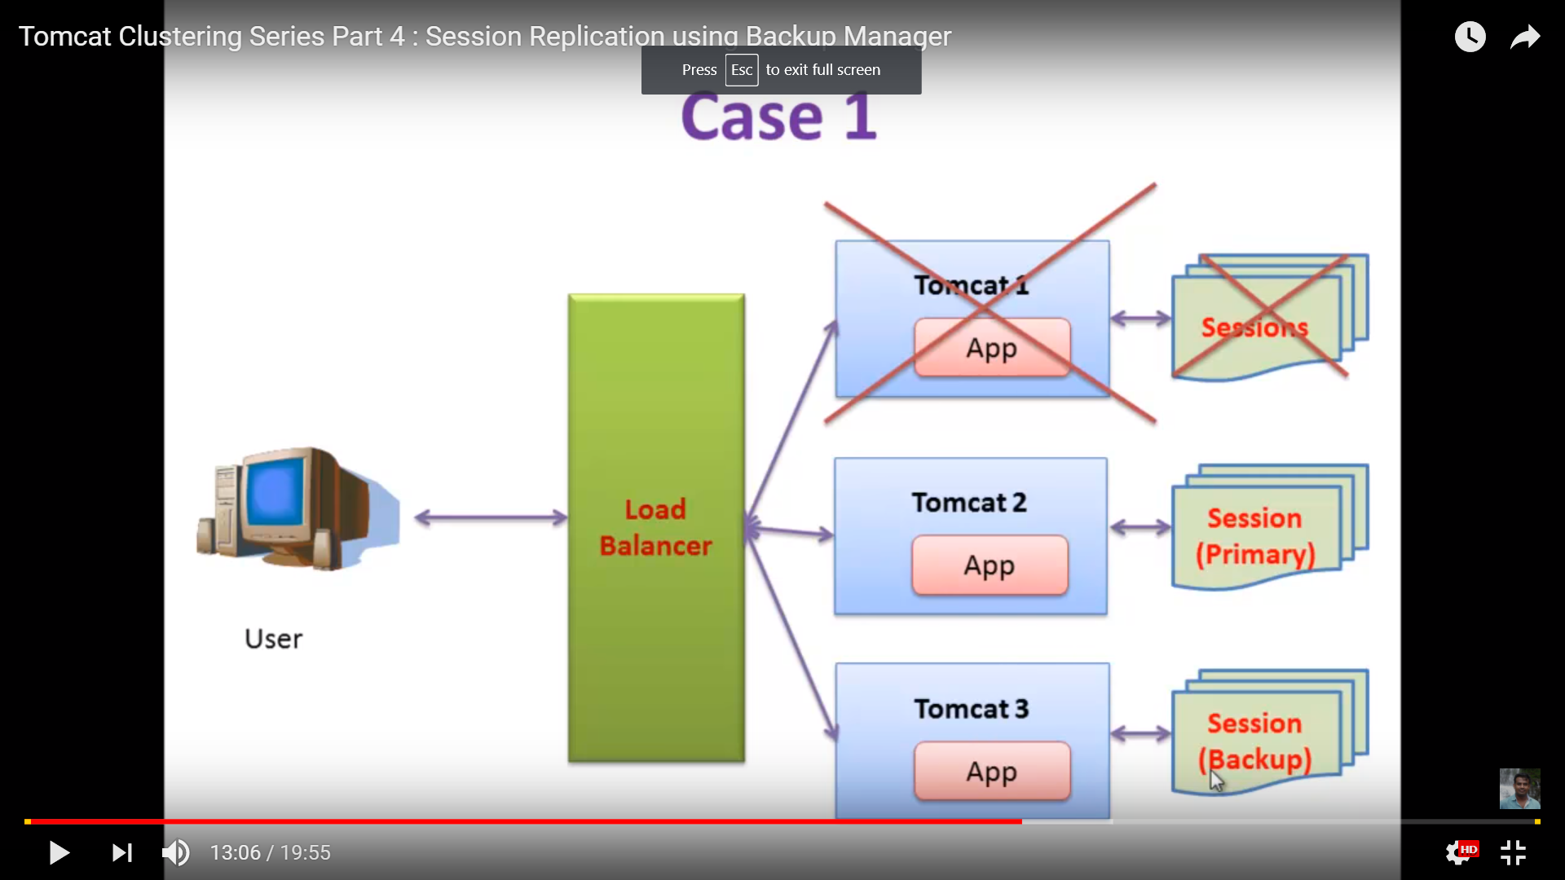
Backup Manager

Slide 122
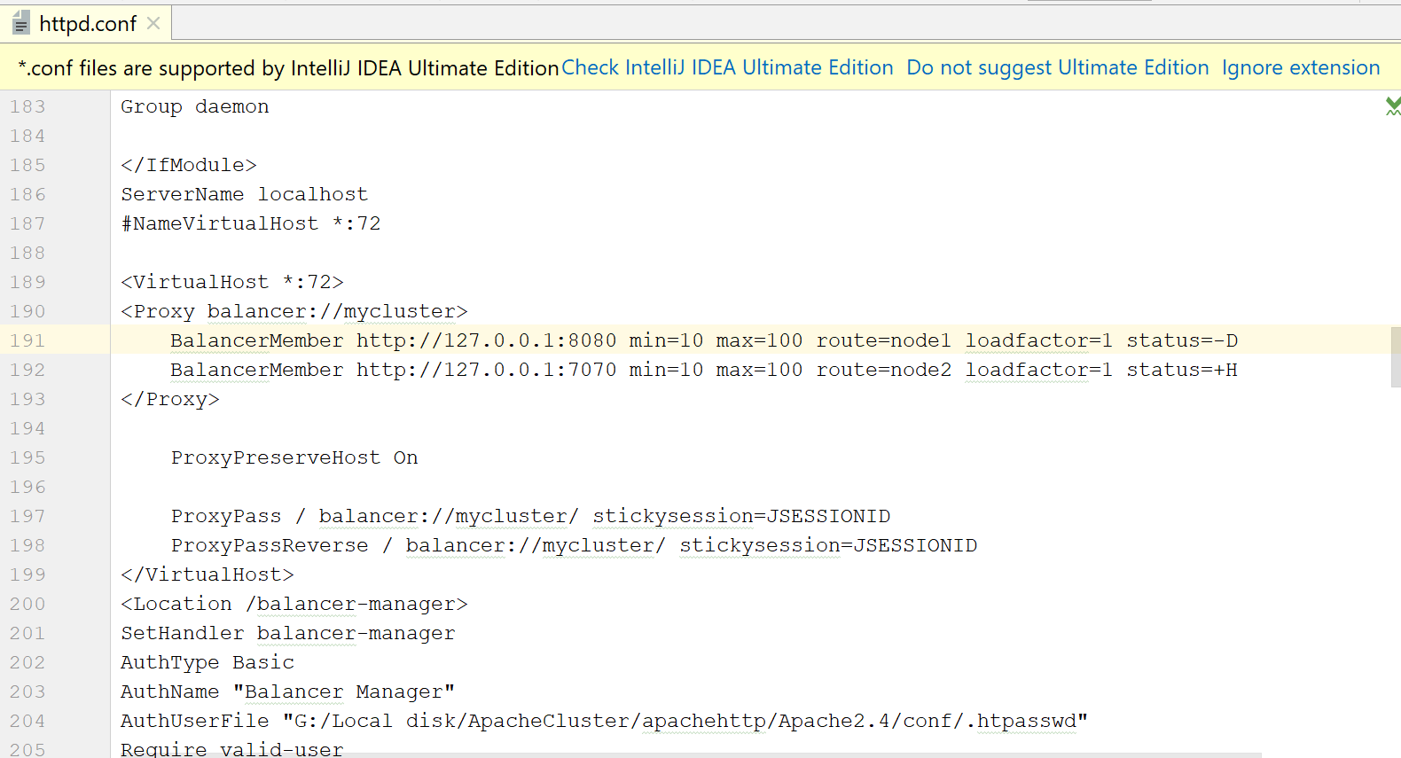
Hot standby

Slide 123
LDAP Authentication
1. Open your CATALINA_HOME/conf/server.xml file, within <Host> element, comment out the current <realm>(by default UserDatabaseRealm) within LockOutRealm realm. If you want you can comment out the whole realms.

Slide 124
LDAP Authentication
1. Add the following realm to replace what has just been commented above
<Realm
className="org.apache.catalina.realm.JNDIRealm"
debug="99"
connectionURL="ldap://ldap.yourdomain.com"
authentication="simple"
referrals="follow"
connectionName="ldapquery"
connectionPassword="password"
userSearch="(sAMAccountName={0})"
userBase="dc=youdomain,dc=com"
userSubtree="true"
userRoleName="memberOf"
roleBase="ou=group,dc=yourdomain,dc=com"
roleSearch="(member={0})"
roleSubtree="true"
roleName="CN" />

